Slide 1
CAPSTONE PROJECT
Social Media Sentiment Analysis
Presented By:
1. D.HAASINI-Alagappa college of technology,Chennai- CERAMIC DEPARTMENT

Slide 2
OUTLINE
Problem Statement
Proposed System/Solution
System Development Approach
Algorithm & Deployment
Result
Conclusion
Future Scope
References

Slide 3
PROBLEM STATEMENT
Social media platforms generate vast volumes of unstructured data, posing a significant challenge in extracting actionable insights effectively. Existing social media analytics solutions encounter issues such as scalability, accuracy, and interpretability, limiting their real-time applicability. The problem statement aims to develop advanced analytics solutions capable of handling diverse data types, adapting to evolving trends, and providing actionable insights across domains like marketing, brand management, and public opinion analysis.

Slide 4
PROPOSED SOLUTION
A proposed solution for social media sentiment analysis could involve using natural language processing (NLP) techniques to analyze text data from social media platforms. This could include steps such as data collection, text preprocessing (like tokenization and stemming), feature extraction (like bag-of-words or word embeddings), and model training (using algorithms like Naive Bayes, Support Vector Machines, or deep learning models such as recurrent neural networks or transformers). Evaluation metrics like accuracy, precision, recall, and F1-score can be used to assess the model's performance. Additionally, it's crucial to continuously update and refine the model to adapt to changing language patterns and user behavior on social media platforms.

Slide 5
SYSTEM APPROACH
Building the proposed solution would involve a combination of data processing, feature engineering, and machine learning. Here are the key system and library requirements:
System Requirements:
Hardware:
A computer with sufficient processing power, preferably with multiple cores or a GPU for faster training of machine learning models.- Adequate RAM to handle the size of the dataset and computational requirements.
Software:-
An operating system compatible with the required machine learning libraries (e.g., Windows, Linux, macOS).

Slide 6
Library Requirements:
1.Data Processing and Analysis:-
Pandas: For data manipulation and analysis
NumPy: For numerical operations on data.
2. Data Visualization:-
Matplotlib and Seaborn: For creating visualizations to understand data patterns.
Plotly or Bokeh: Interactive visualization libraries for more complex visualizations.

Slide 7
ALGORITHM & DEPLOYMENT
Algorithm:
Sentiment Analysis using Multinomial Naive Bayes
1. Data Preprocessing: Remove noise from text data, including URLs, non-alphabetic characters, and stopwords. Convert text to lowercase for consistency
2. Feature Extraction: Utilize TF-IDF vectorization to convert text data into numerical feature vectors. Transform both training and testing data into TF-IDF representation.
3. Model Training: Train a Multinomial Naive Bayes classifier on the TF-IDF transformed training data. This algorithm assumes independence between features and follows a multinomial distribution, making it suitable for text classification tasks.
4. Prediction: Predict sentiment labels for testing data using the trained Multinomial Naive Bayes model.
5. Evaluation:*Assess model performance by calculating accuracy and generating a classification report containing precision, recall, and F1-score for each sentiment class.
.

Slide 8
Deployment Statement:
1.Model Serialization:Serialize the trained model along with TF-IDF vectorizer for easy deployment.
2. API Development:Develop an API using Flask or Django to expose endpoints for sentiment analysis.
3. Containerization: Containerize the API using Docker for consistency and portability.
4. Deployment to Cloud:*Deploy the Docker container to a cloud platform like AWS, GCP, or Azure using compute services like EC2 or Compute Engine.
5. Monitoring and Scaling:Implement monitoring tools for real-time performance tracking and auto-scaling policies to adjust container instances based on workload demands.
6. API Documentation:Provide comprehensive documentation for API usage, input/output formats, and security measures.
7. Security Measures: Implement authentication, authorization, and encryption to protect API endpoints and data transmission. Regularly update dependencies for security compliance.
By following this brief deployment statement, the sentiment analysis model can be deployed as a scalable and secure service, enabling real-time sentiment analysis on social media data.

Slide 9
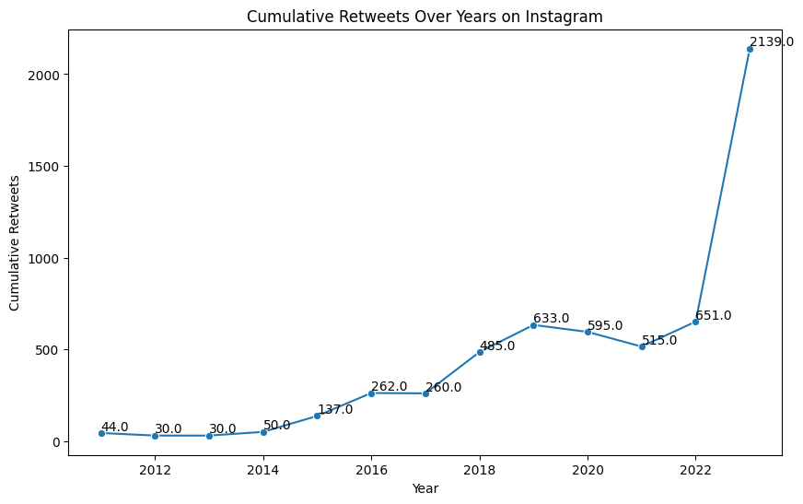
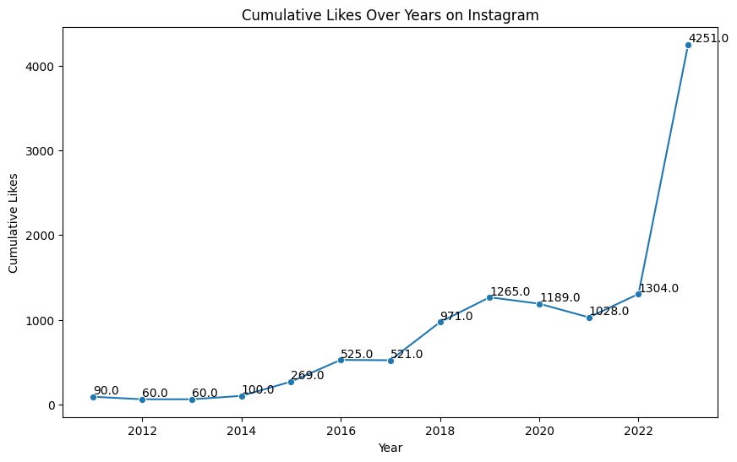
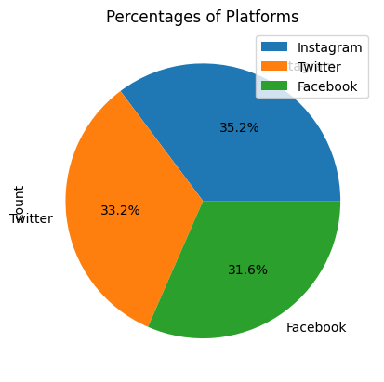
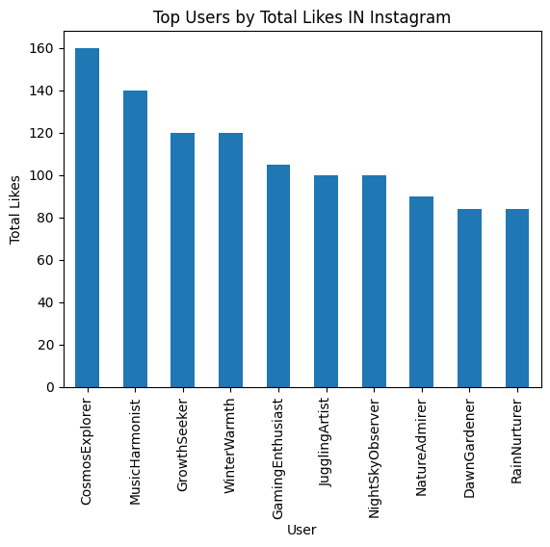
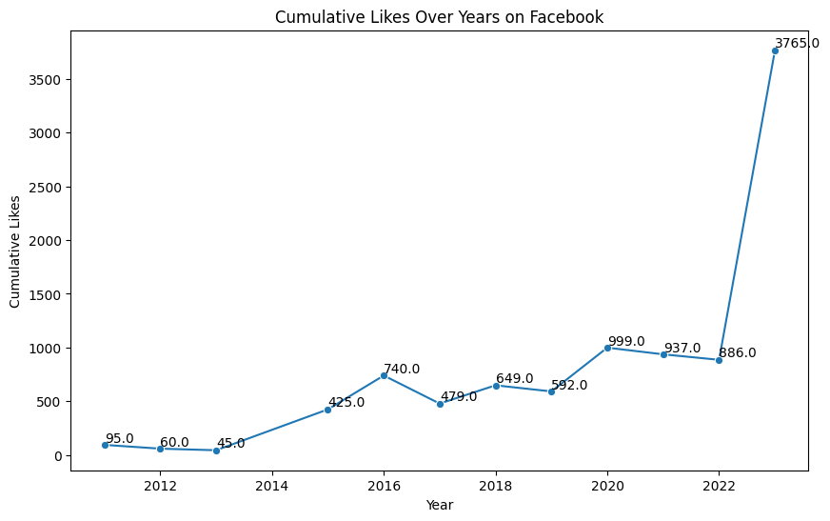
RESULT

Slide 10
CONCLUSION
The developed solution offers a robust and efficient approach to analyzing sentiment in social media data, crucial for brand management and customer engagement strategies. By employing the Multinomial Naive Bayes algorithm and TF-IDF feature extraction, the model demonstrates reliable sentiment classification accuracy. Moreover, the deployment plan ensures seamless integration of the sentiment analysis model into real-time applications through containerization and cloud deployment. This solution empowers businesses to monitor brand perception, address customer concerns promptly, and optimize marketing strategies, ultimately fostering improved brand reputation and customer satisfaction.

Slide 11
FUTURE SCOPE
The project has several avenues for future development and enhancement:
1.Language Diversity:
Expansion of language support to encompass a broader range of languages and dialects.
2.Interpretability: Development of techniques for more interpretable sentiment analysis results, aiding in decision-making processes.
3.User Engagement: Integration of sentiment analysis insights into user engagement strategies for brands and organizations.
4.Collaborative Filtering: Exploration of collaborative filtering methods to incorporate user preferences and feedback for personalized sentiment analysis.

Slide 12
REFERENCES
https://www.kaggle.com
https://colab.research.google.com/?utm_source=scs-index

Slide 13
THANK YOU

